Slide 1

Prediction Model on Motor Insurance Renewal
An NTUC Income use case
Sameer Panda

Slide 2
Analysis
Approach
Dataset contains existing customer base having motor insurance policies at a global insurance firm
Train and Test datasets with 382154 & 78273 records given
EDA to understand the basic traits of the data & insights
Data pre-processing to prepare the data for modelling
Training the model and fine-tuning projection
Reporting accuracy on selected model & Feature importance

Slide 3
Executive Summary
Insights
Based on the test dataset of 78273 customers, 43% were expected to renew their existing policies based on the customer propensity score of higher than 0.5 as per the trained model prediction with 82% accuracy
Factor
“Vehicle damage” is the largest factor in determining if the customer is willing to renew their existing policies
Recommendations
Model could be further trained with a live database of customer information with additional details such as NPS (Net Promotor Score)

Slide 4
Appendix
Libraries used
Exploratory Data Analysis
Data Pre-Processing
Train-Validation split & Model Training
Picking the best model & feature importance
Future Enhancements

Slide 5
Libraries used
1 | pandas | Data analysis
2 | numpy | Mathematical functions
3 | matplotlib.pyplot | Visualization interface
4 | seaborn | Statistical visualization
5 | sklearn | Predictive data analysis
6 | imblearn | Imbalanced classification
7 | csv | csv format

Slide 6
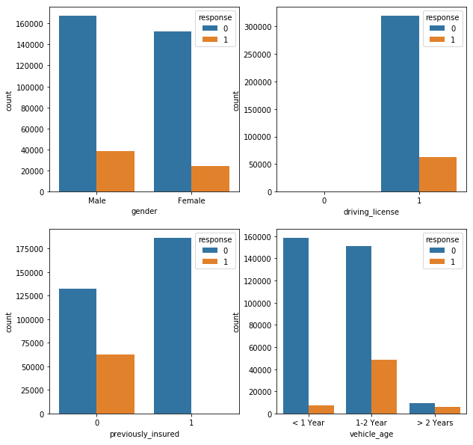
Exploratory
Data
Analysis
Analysis on Train data

Slide 7
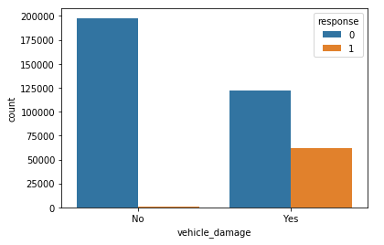
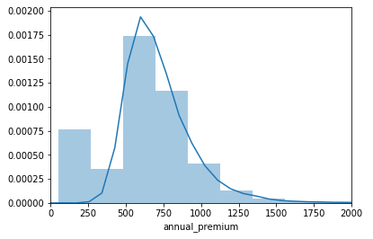
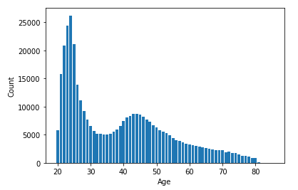
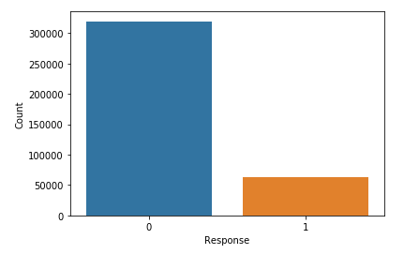
Exploratory
Data
Analysis
Analysis on Train data

Slide 8
Data
Pre-Processing
Preparing the data for modelling involves the following preprocessing techniques-
  Doing categorical encoding
  Binning the numerical features.
  Dropping the unnecessary columns like ids.
Select columns (features) to be used in model training

Slide 9
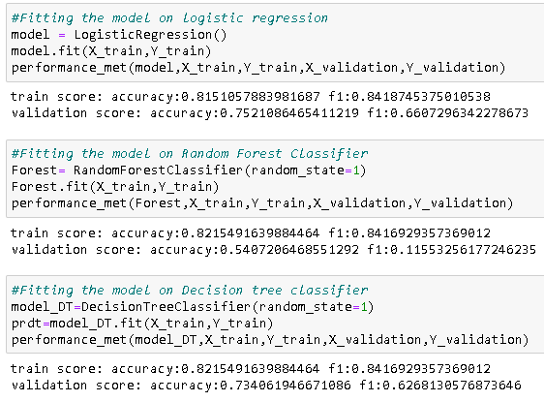
Train-Validation
Split
30% of the train dataset is kept for validation
70% of the dataset is used for training the models
Random oversampling is performed on the training dataset before fitting to different models
Decision Tree classifier model trained at 82% accuracy

Slide 10
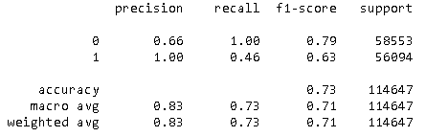
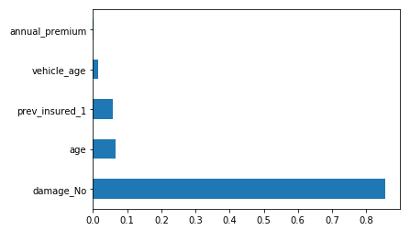
Model Accuracy
Decision Tree Classifier
Classification Report
Decision Tree Classifier at 73% accuracy on validation dataset
Feature Importance
The status of damage of the customer’s vehicle is a major factor in determining if the motor insurance would be renewed by the customer or not

Slide 11
User Propensity
43% to renew

Slide 12
Future
Enhancements
Hyperparameter tuning could be performed to improve the model accuracy
To expand on this analysis, cross-selling prediction could be performed
Live dataset on consumer data could be connected from different industries to improve the user propensity modelling
Additional parameters and performance metrics such as Net Promotor Score (NPS) can be used to improve and build on the model
Each actionable historic user info can be used for data driven decisions

